Slide 1
Email
By Maison Roberts

Slide 2
The advantages and disadvantages of email
Advantages:
Available 24/7
Sends Instantly
Can send to multiple recipients
Disadvantages:
Can only use when you have mobile data or internet
Spam, Viruses and Phishing

Slide 3


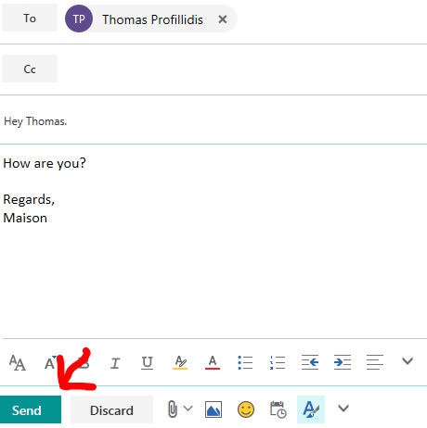
How to send Emails
To send an email you do this: Hit new:
Then Choose the Person you want to send to:
Then Choose your subject and what you want to say and hit send:

Slide 4
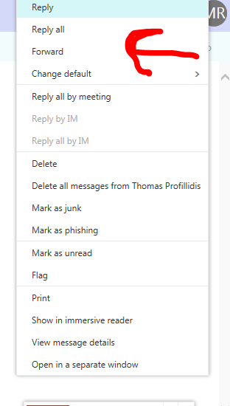
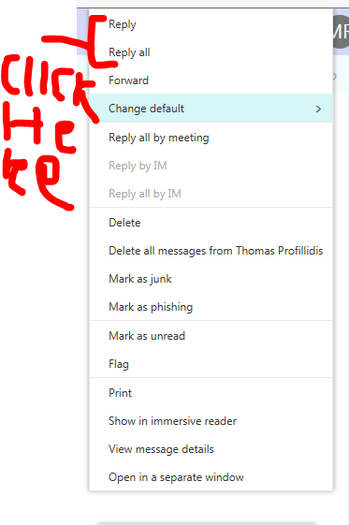
How to respond and Forward
To Forward do this:
To respond do this:

Slide 5


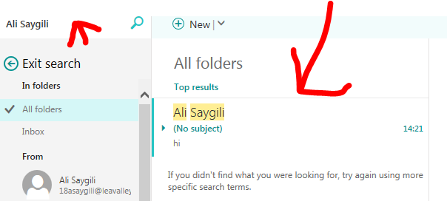
How to search your old emails for a sender, subject, etc
This is what you do to search for emails:
Then type the recipients name:
Then hit enter
And your
Email shows up

Slide 6
How to resize large image files before sending
Open Snipping tool then go to the picture and save it as a bigger or smaller picture

Slide 7
How to manage your contacts list

